Slide 1


Preparing Future STEM Educators
Women in STEM Roadshow
Karen E. Irving, Ph.D.
February 2018
Notes:
Thompson Library, West view

Slide 2

Notes:
Thompson Library, West view
My great pleasure to be with you today for this auspicious occasion. I bring you greetings from the Ohio State University. This snowy image of our main library is what I left to join you in the glorious Aligarh Muslim University for our conference.
I would like to thank
Vice Chancellor General Shah
Pro Vice Chancellor Ali
Professor Imrana Naseem
Honored guests
Honored faculty
Students
Greet Dignitaries
Thanks to

Slide 3
Overview
STEM professional supply and demand
What is STEM?
What is science?
What is science education?
STEM learning challenges

Slide 4

Background
What is STEM?
Science
Technology
Engineering
Mathematics

Slide 5
What is Science Education?
Background
Sharing of science content and processes
Learners may be children, college students, or adults
Includes scientific methodologies, social sciences, and science of learning & teaching
Includes many different science disciplines

Slide 6
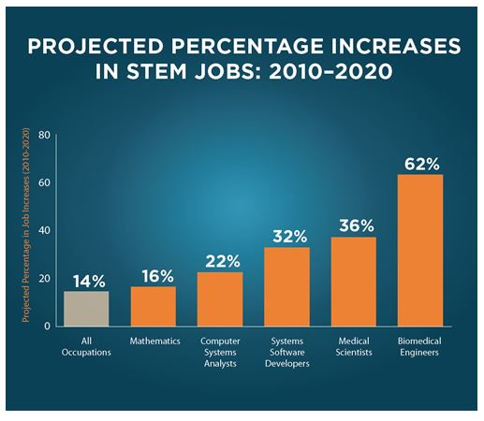
Background
Supply & Demand
US Department of Education, http://www.ed.gov/stem 2016

Slide 7


The Learning Challenge
Only ~16% of US high school seniors are proficient in math and science
~40% of U.S. students who enter college with declared STEM majors, switch majors.
If Pre-Med students are counted, ~60% leave STEM fields
Drew, 2011
Notes:
Squandering talent;

Slide 8




The Learning Challenge
Students have choices about what to study.
Drew, 2011
Notes:
Turn STEM majors into legislators who control STEM budgets. Not a good plan.

Slide 9
The Problem
Increase the supply of talented STEM professionals
Teaching and learning STEM is difficult
High quality graduates are needed
How can you broaden access to STEM education in India?

Slide 10
Preparing to Teach
Effective teaching is challenging
STEM teacher candidates must understand their STEM content as well as how to teach that STEM content to others.

Slide 11
Good Teaching Matters
Systematic, planned, implemented and evaluated educational programs work better
Realistic and measurable outcomes are needed
Talented teachers help produce talented scientists, engineers, and mathematicians

Slide 12
Science of Teaching
& Learning
If you want to know how to help people learn, you should know something about how learning works.
If you want to be an effective teacher, you should know what works in the classroom.
Meyer, 2011, p vii

Slide 13
PSYCHOLOGY
Study of mental processes responsible for cognition
& behavior
Pedagogy & ANDRAGOGY
Study of the science of teaching
NEUROSCIENCE
Study of the brain’s development, structure and function
Notes:
Educational psychology is the branch of psychology concerned with the scientific study of human learning. The study of learning processes, from both cognitive and behavioral perspectives, allows researchers to understand individual differences in intelligence, cognitive development, affect, motivation, self-regulation, and self-concept, as well as their role in learning. The field of educational psychology relies heavily on quantitative methods, including testing and measurement, to enhance educational activities related to instructional design, classroom management, assessment, which serve to facilitate learning processes in various educational settings across the lifespan.^{[1]}
Pedagogy is the discipline that deals with the theory and practice of education; it thus concerns the study and practice of how best to teach. Its aims range from the general (full development of the human being via liberal education) to the narrower specifics of vocational education (the imparting and acquisition of specific skills).
For example, Paulo Freire referred to his method of teaching people as "critical pedagogy". In correlation with those instructive strategies, the instructor's own philosophical beliefs of instruction are harbored and governed by the pupil's background knowledge and experience, situation, and environment, as well as learning goals set by the student and teacher. One example would be the Socratic schools of thought.^{[1][2][3]} The teaching of adults, however, may be referred to as andragogy.
Neuroscience is the scientific study of the nervous system.^{[1]} Traditionally, neuroscience has been seen as a branch of biology. However, it is currently an interdisciplinaryscience that collaborates with other fields such as chemistry, cognitive science, computer science, engineering, linguistics, mathematics, medicine (including neurology),genetics, and allied disciplines including philosophy, physics, and psychology. It also exerts influence on other fields, such as neuroeducation,^{[2]} neuroethics, andneurolaw. The term neurobiology is usually used interchangeably with the term neuroscience, although the former refers specifically to the biology of the nervous system, whereas the latter refers to the entire science of the nervous system.

Slide 14
PSYCHOLOGY
Study of mental processes responsible for cognition
& behavior
Pedagogy & ANDRAGOGY
Study of the science of teaching
EDUCATIONAL NEUROSCIENCE
NEUROSCIENCE
Study of the brain’s development, structure and function
Notes:
Educational neuroscience (or neuroeducation,^{[1]} a component of Mind Brain and Education) is an emerging scientific field that brings together researchers in cognitive neuroscience, developmental cognitive neuroscience, educational psychology, educational technology, education theory and other related disciplines to explore the interactions between biological processes and education.^{[2][3][4][5]}
Researchers in educational neuroscience investigate the neural mechanisms of reading,^{[4]} numerical cognition,^{[6]} attention and their attendant difficulties including dyslexia,^{[7][8]} dyscalculia^{[9]} and ADHD as they relate to education.
Researchers in this area may link basic findings in cognitive neuroscience with educational technology to help in curriculum implementation for mathematics education and reading education.
The aim of educational neuroscience is to generate basic and applied research that will provide a new transdisciplinary account of learning and teaching, which is capable of informing education. A major goal of educational neuroscience is to bridge the gap between the two fields through a direct dialogue between researchers and educators, avoiding the "middlemen of the brain-based learning industry". These middlemen have a vested commercial interest in the selling of "neuromyths" and their supposed remedies.^{[4]}
The potential of educational neuroscience has received varying degrees of support from both cognitive neuroscientists and educators. Davis^{[10]} argues that medical models of cognition, "...have only a very limited role in the broader field of education and learning mainly because learning-related intentional states are not internal to individuals in a way which can be examined by brain activity." Pettito and Dunbar^{[11]} on the other hand, suggest that educational neuroscience "provides the most relevant level of analysis for resolving today’s core problems in education."
Howard-Jones and Pickering^{[12]} surveyed the opinions of teachers and educators on the topic, and found that they were generally enthusiastic about the use of neuroscientific findings in the field of education, and that they felt these findings would be more likely to influence their teaching methodology than curriculum content. Some researchers take an intermediate view and feel that a direct link from neuroscience to education is a "bridge too far",^{[13]} but that a bridging discipline, such as cognitive psychology or educational psychology^{[14]} can provide a neuroscientific basis for educational practice. The prevailing opinion, however, appears to be that the link between education and neuroscience has yet to realise its full potential, and whether through a third research discipline, or through the development of new neuroscience research paradigms and projects, the time is right to apply neuroscientific research findings to education in a practically meaningful way.^{[2][4][5]}
Several academic institutions around the world are beginning to devote resources and energy to the establishment of research centres focused on educational neuroscience research. For example, the Centre for Educational Neuroscience in London UK is an inter-institutional project between University College, London, Birkbeck and the Institute of Education. The centre brings together researchers with expertise in the fields of emotional, conceptual, attentional, language and mathematical development, as well as specialists in education and learning research with the aim of building a new scientific discipline (Educational Neuroscience) in order to ultimately promote better learning.

Slide 15
Educational Neuroscience
Emerging scientific field
Explores the interactions between biological processes and education
Cognitive neuroscience
Educational psychology
Educational technology
Educational theory
Meyer, 2011, p 2
Notes:
Definition: science of learning – is the scientific study of how people learn
Goal: research based model of how learning works
Criterion – theories are testable
Science of instruction – how to help people learn
Research based principles of instructional design indicating which methods work for teaching which kinds of knowledge to which kinds of student under what context
Science of assessment – how to determine what people know;
Valid and reliable instruments for assessing learning outcomes, learning processes, and learning capabilities

Slide 16
Preparing STEM Educators
STEM content knowledge
STEM research experience
Science of learning (instruction & assessment)
Teaching practice & mentoring
Notes:
Definition: science of learning – is the scientific study of how people learn
Goal: research based model of how learning works
Criterion – theories are testable
Science of instruction – how to help people learn
Research based principles of instructional design indicating which methods work for teaching which kinds of knowledge to which kinds of student under what context
Science of assessment – how to determine what people know;
Valid and reliable instruments for assessing learning outcomes, learning processes, and learning capabilities

Slide 17
Teaching & Learning
Instruction
Learning
Assessment
Meyer, 2011, p 2
Notes:
Definition: science of learning – is the scientific study of how people learn
Goal: research based model of how learning works
Criterion – theories are testable
Science of instruction – how to help people learn
Research based principles of instructional design indicating which methods work for teaching which kinds of knowledge to which kinds of student under what context
Science of assessment – how to determine what people know;
Valid and reliable instruments for assessing learning outcomes, learning processes, and learning capabilities

Slide 18
Teaching and Learning in the 21st century
Post-millennial technologies have changed the nature of pedagogy & andragogy
Opportunities for students to engage with content have changed

Slide 19


Teaching and Learning in the 21st century
Huge volumes of information instantly available
Time and distance barriers different
Networking opportunities vastly increased
OERs and GNUs reduce financial burden
Notes:
MOOC – massive open online courses
OER – open educational resources
TED talks (Technology, Entertainment & Design) Nonprofit; spread ideas, short powerful talks 18 mibnutes or less; 1984 founded; TEDx events help shape ideas in communities and around the world. Kids can teach themselves, Sugata Mitra, Hole in the Wall Computing project
https://www.ted.com/talks/sugata_mitra_shows_how_kids_teach_themselves?language=en
Open educational resources often involve issues relating to intellectual property rights. Traditional educational materials, such as textbooks, are protected under conventional copyright terms. However, alternative and more flexible licensing options have become available as a result of the work of Creative Commons, an organization that provides ready-made licensing agreements that are less restrictive than the "all rights reserved" terms of standard international copyright. These new options have become a "critical infrastructure service for the OER movement."^{[30]} Another license, typically used by developers of OER software, is the GNU General Public License from the free and open-source software (FOSS) community. Open licensing allows uses of the materials that would not be easily permitted under copyright alone.^{[31]}
Types of open educational resources include: full courses, course materials, modules, learning objects, open textbooks, openly licensed (often streamed) videos, tests, software, and other tools, materials, or techniques used to support access to knowledge. OER may be freely and openly available static resources, dynamic resources which change over time in the course of having knowledge seekers interacting with and updating them (such as this Wikipedia article), or a course or module with a combination of these resources.

Slide 20
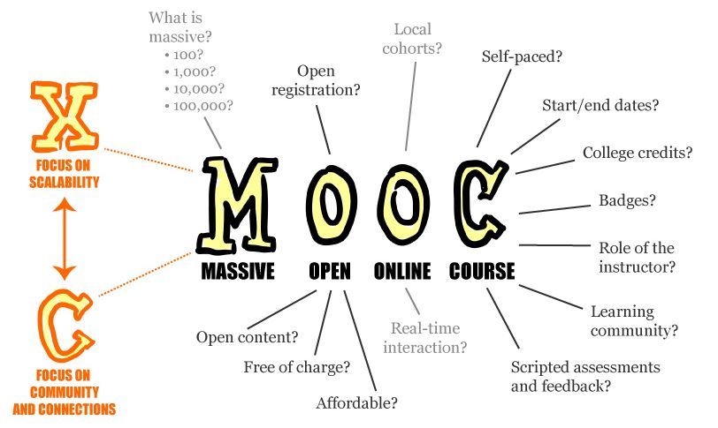
Teaching and Learning in the 21st century
Notes:
MOOC – massive open online courses
OER – open educational resources
TED talks (Technology, Entertainment & Design) Nonprofit; spread ideas, short powerful talks 18 mibnutes or less; 1984 founded; TEDx events help shape ideas in communities and around the world. Kids can teach themselves, Sugata Mitra, Hole in the Wall Computing project
https://www.ted.com/talks/sugata_mitra_shows_how_kids_teach_themselves?language=en
Open educational resources often involve issues relating to intellectual property rights. Traditional educational materials, such as textbooks, are protected under conventionalcopyright terms. However, alternative and more flexible licensing options have become available as a result of the work of Creative Commons, an organization that provides ready-made licensing agreements that are less restrictive than the "all rights reserved" terms of standard international copyright. These new options have become a "critical infrastructure service for the OER movement."^{[30]} Another license, typically used by developers of OER software, is the GNU General Public License from the free and open-source software (FOSS) community. Open licensing allows uses of the materials that would not be easily permitted under copyright alone.^{[31]}
Types of open educational resources include: full courses, course materials, modules, learning objects, open textbooks, openly licensed (often streamed) videos, tests, software, and other tools, materials, or techniques used to support access to knowledge. OER may be freely and openly available static resources, dynamic resources which change over time in the course of having knowledge seekers interacting with and updating them (such as this Wikipedia article), or a course or module with a combination of these resources.

Slide 21
MOOCs at Ohio State University (OSU)
Provide for the common good
Platform to experiment with different teaching methods
Collect data about technology-empowered learning experiences
Reach a global audience
Promote awareness about the university
Boost enrollment
Notes:
MOOC – massive open online courses
OER – open educational resources
TED talks (Technology, Entertainment & Design) Nonprofit; spread ideas, short powerful talks 18 mibnutes or less; 1984 founded; TEDx events help shape ideas in communities and around the world. Kids can teach themselves, Sugata Mitra, Hole in the Wall Computing project
https://www.ted.com/talks/sugata_mitra_shows_how_kids_teach_themselves?language=en
BENEFITS FROM TAKING A MOOC
The benefits of taking a MOOC go beyond the convenience of being online. Interested students now have an opportunity to join a growing online community where they can openly discuss the topic of the course, discover and share additional resources, as well as interact with their instructor. These discussions are vital to the learning process and may have important implications in the field, depending on the topic of conversation. MOOCs also provide learners with free and open access to a diverse library of courses featuring Ohio State faculty expertise and research. Lastly, MOOCs are developed with the idea that you can fit the course around your schedule. Upon full completion of the course, you can expect to receive a Statement of Accomplishment from Coursera indicating your achievement in completing the assignments and assessments pertaining to that course.

Slide 22
MOOCs at OSU
2012 partnership with Coursera to offer MOOCs
By 2013, >101,000 students from 150+ countries enrolled
Expanding the global impact of the university while helping to inform the way we teach on campus.
Notes:
MOOC – massive open online courses
OER – open educational resources
TED talks (Technology, Entertainment & Design) Nonprofit; spread ideas, short powerful talks 18 mibnutes or less; 1984 founded; TEDx events help shape ideas in communities and around the world. Kids can teach themselves, Sugata Mitra, Hole in the Wall Computing project
https://www.ted.com/talks/sugata_mitra_shows_how_kids_teach_themselves?language=en
BENEFITS FROM TAKING A MOOC
The benefits of taking a MOOC go beyond the convenience of being online. Interested students now have an opportunity to join a growing online community where they can openly discuss the topic of the course, discover and share additional resources, as well as interact with their instructor. These discussions are vital to the learning process and may have important implications in the field, depending on the topic of conversation. MOOCs also provide learners with free and open access to a diverse library of courses featuring Ohio State faculty expertise and research. Lastly, MOOCs are developed with the idea that you can fit the course around your schedule. Upon full completion of the course, you can expect to receive a Statement of Accomplishment from Coursera indicating your achievement in completing the assignments and assessments pertaining to that course.

Slide 23
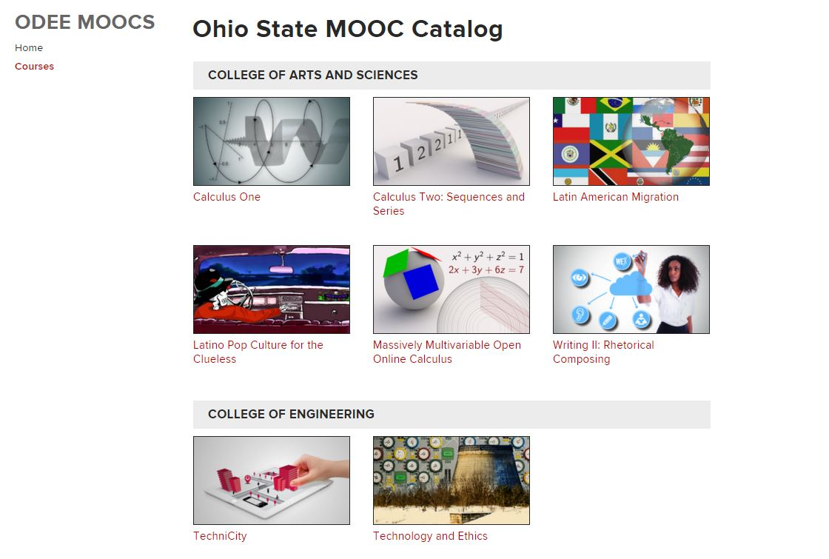
Notes:
MOOC – massive open online courses
OER – open educational resources
TED talks (Technology, Entertainment & Design) Nonprofit; spread ideas, short powerful talks 18 mibnutes or less; 1984 founded; TEDx events help shape ideas in communities and around the world. Kids can teach themselves, Sugata Mitra, Hole in the Wall Computing project
https://www.ted.com/talks/sugata_mitra_shows_how_kids_teach_themselves?language=en
Open educational resources often involve issues relating to intellectual property rights. Traditional educational materials, such as textbooks, are protected under conventionalcopyright terms. However, alternative and more flexible licensing options have become available as a result of the work of Creative Commons, an organization that provides ready-made licensing agreements that are less restrictive than the "all rights reserved" terms of standard international copyright. These new options have become a "critical infrastructure service for the OER movement."^{[30]} Another license, typically used by developers of OER software, is the GNU General Public License from the free and open-source software (FOSS) community. Open licensing allows uses of the materials that would not be easily permitted under copyright alone.^{[31]}
Types of open educational resources include: full courses, course materials, modules, learning objects, open textbooks, openly licensed (often streamed) videos, tests, software, and other tools, materials, or techniques used to support access to knowledge. OER may be freely and openly available static resources, dynamic resources which change over time in the course of having knowledge seekers interacting with and updating them (such as this Wikipedia article), or a course or module with a combination of these resources.

Slide 24
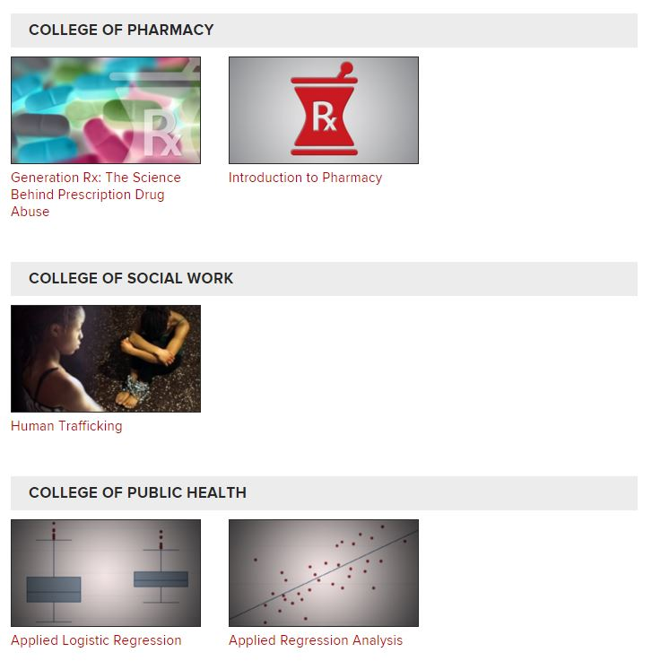
Notes:
MOOC – massive open online courses
OER – open educational resources
TED talks (Technology, Entertainment & Design) Nonprofit; spread ideas, short powerful talks 18 mibnutes or less; 1984 founded; TEDx events help shape ideas in communities and around the world. Kids can teach themselves, Sugata Mitra, Hole in the Wall Computing project
https://www.ted.com/talks/sugata_mitra_shows_how_kids_teach_themselves?language=en
Open educational resources often involve issues relating to intellectual property rights. Traditional educational materials, such as textbooks, are protected under conventionalcopyright terms. However, alternative and more flexible licensing options have become available as a result of the work of Creative Commons, an organization that provides ready-made licensing agreements that are less restrictive than the "all rights reserved" terms of standard international copyright. These new options have become a "critical infrastructure service for the OER movement."^{[30]} Another license, typically used by developers of OER software, is the GNU General Public License from the free and open-source software (FOSS) community. Open licensing allows uses of the materials that would not be easily permitted under copyright alone.^{[31]}
Types of open educational resources include: full courses, course materials, modules, learning objects, open textbooks, openly licensed (often streamed) videos, tests, software, and other tools, materials, or techniques used to support access to knowledge. OER may be freely and openly available static resources, dynamic resources which change over time in the course of having knowledge seekers interacting with and updating them (such as this Wikipedia article), or a course or module with a combination of these resources.

Slide 25
Teaching and Learning in the 21st century
Established practices are challenged by modern technologies
Lecture halls
Rigid timelines
Schedules
Controlled access to learning resources
Traditional practice
Notes:
MOOC – massive open online courses
OER – open educational resources

Slide 26
Teaching and Learning in the 21st century
Student choice in learning pathways
Changing relationships between students and universities
Administrator choice of ‘free’ resources like TED talks, MOOCs, OERs
Student expectations for digital and social media
Notes:
MOOC – massive open online courses
OER – open educational resources
Ted –Technology, entertainment, design

Slide 27
Teaching and Learning in the 21st century
Must be relevant & competitive
Provides knowledge and skills on the cutting edge
Students must know how and know what
Collaborative teamwork skills important
Making informed choices with incomplete information
Notes:
MOOC – massive open online courses
OER – open educational resources

Slide 28
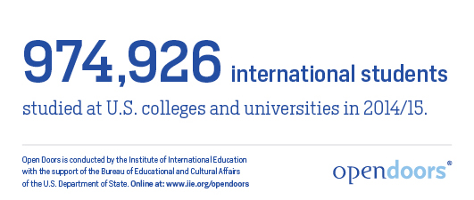
International Students in the USA

Slide 29
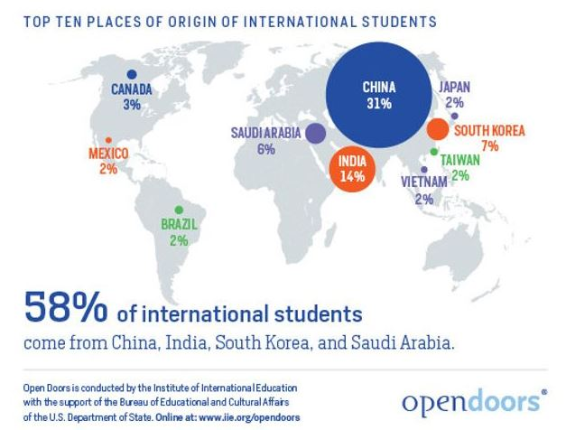
Global Community

Slide 30
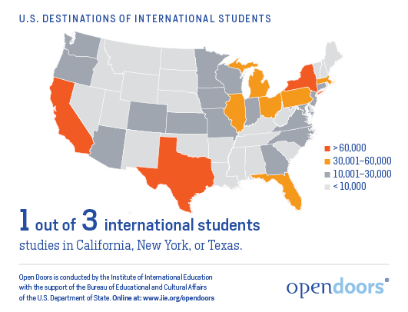
Distribution in the US

Slide 31
India’s Challenge
Competitive higher education environment
Global economy
21st century communications opening new educational opportunities
Improved pre college educational opportunities
Enormous human capital potential

Slide 32
Science Inquiry
What kinds of questions can science answer?
How do scientists design and conduct science investigations?
What kinds of tools and techniques do they use?

Slide 33
Science Inquiry
How do they recognize alternative theories?
How do they communicate problems & explanations?

Slide 34
Let’s try a small Science Inquiry
What do you observe?
What can you infer?
What is the difference between an observation and an inference?

Slide 35
Let’s try a small Science Inquiry
If we look at the 6th side of the cube, what will we see?
With your group – come to a decision.
Provide evidence to support your decision.

Slide 36
Let’s try a more difficult Science Inquiry
Each group has one cube. Do not touch the cube with your hands. You may use the small wooden spoon to touch it.
Do not turn it over.
Collect evidence about the cube.

Slide 37
Let’s try a more difficult Science Inquiry
What do you observe?
What can you infer?
What do you think you will find on the hidden side?
Make an argument supported with evidence for your ideas.

Slide 38
Let’s try a more difficult Science Inquiry
How confident are you in your argument?
Could you be wrong?
Is there more than one possible choice?

Slide 39
Let’s try a more difficult Science Inquiry
What information might help you decide between the alternatives?
A new technology has been invented that could help you gather more information….

Slide 40
Let’s try a more difficult Science Inquiry
Use your new technology to check one number on the corner of the hidden side.
What number do you find?
Does this information help you decide among different alternatives?

Slide 41
Lesson Design – 5E
Engage
Explore
Explain
Elaborate
Evaluate

Slide 42
What does this lesson teach?
Scientific explanations are
Based on empirical data
Made in the public space
Tentative
Historical (based on previous info)
Probabilistic (statistically based)
Assume cause-effect
Limited

Slide 43
How to find the lesson
National Academy of Science (NAS)
Teaching about Evolution and the Nature of Science
http://www.nap.edu/catalog/5787.html

Slide 44
Take Home Thoughts
India needs talented STEM professionals
Excellent teachers are needed to produce STEM professionals
Teaching is based on science
You can be a STEM teacher and contribute to the future of India

Slide 45




Thank You
Dr. Karen E. Irving
Irving.8@osu.edu

